Slide 1
Advanced Omics final project

Slide 2
Goal: Determine distinct GCB transcriptional profile in Human Tonsil Cells
RNA seq data of 3 cell types :
Germinal Center B cells (GCB)
Germinal Center follicular helper T cells (GCTFH)
Regulatory T cells (Tregs)
Samples for RNA seq isolated from Human tonsils

Slide 3
Workflow to generate samples
Tonsils received and processed to single cell suspension
Single Cell suspension stained and prepped for sorting
Samples into individual cell types sorted via FACS on BD FACS Aria Fusion
Sorted cell types sent for RNA sequencing
FASTQ files analyzed via
NF-Core RNA-seq pipeline
Transcriptional Data analyzed via python for differential gene expression

Slide 4
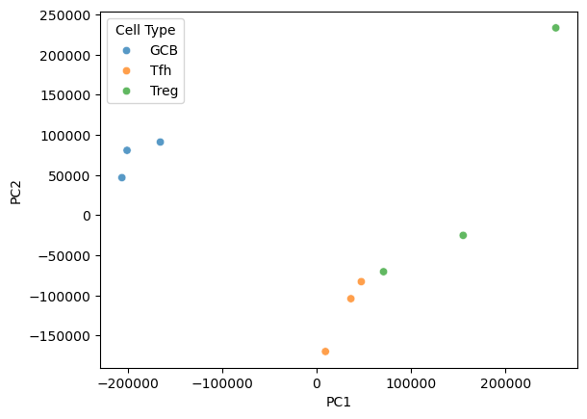
PCA dimensionality reduction indicates distinct profile of GCB cells

Slide 5
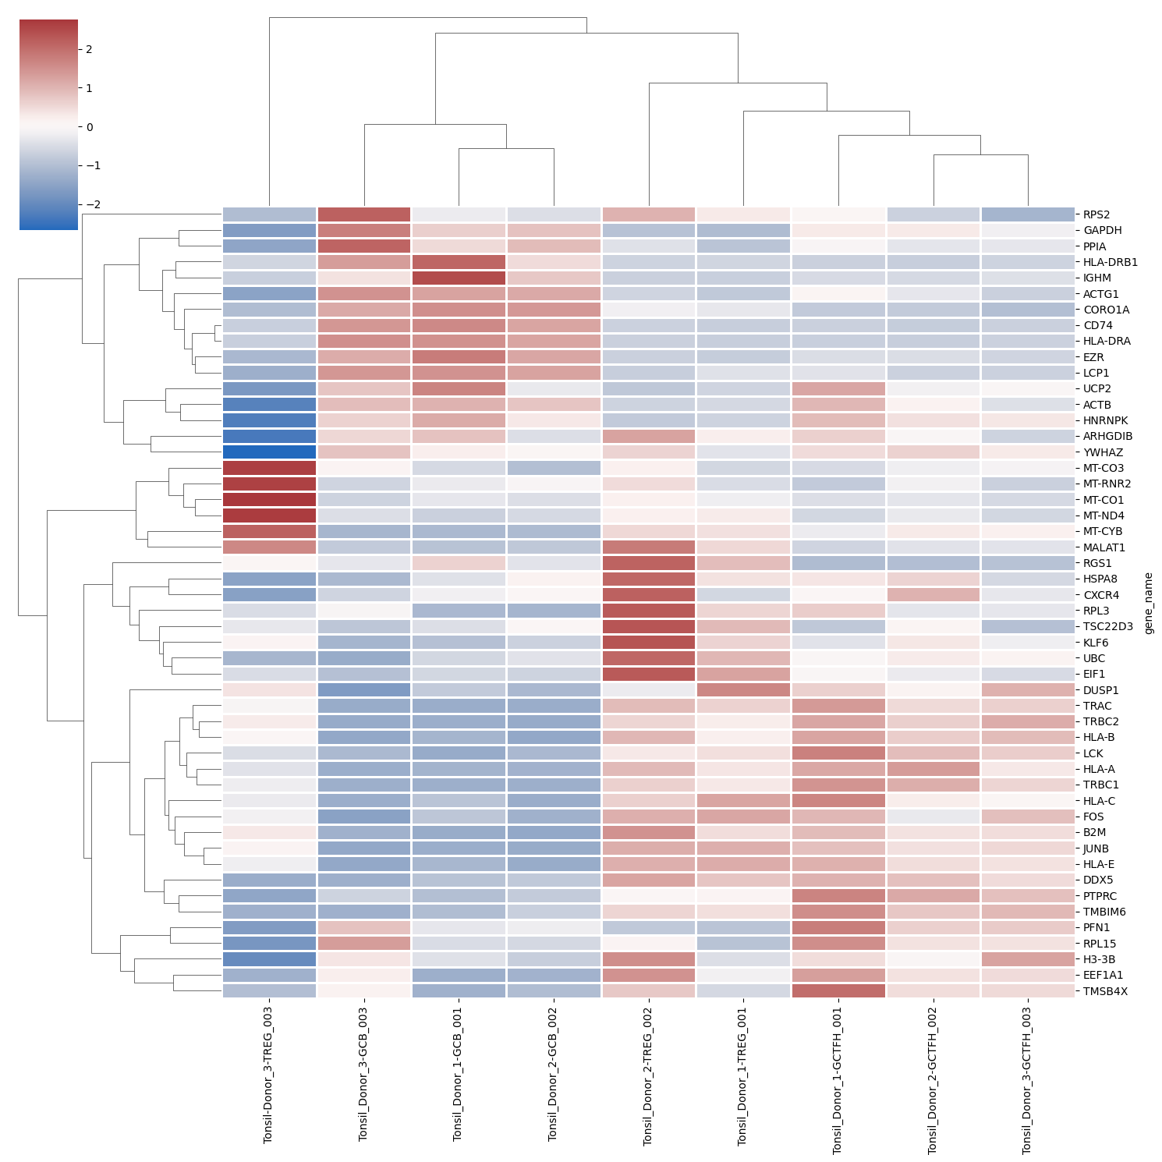
Heatmap of transcriptional profile
Heatmap of top expressed genes across each donor and cell type
Evaluating transcription of top 50 genes

Slide 6
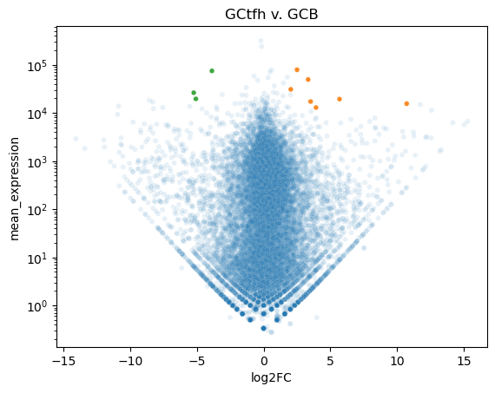
Comparing Expression profile of GCTFH and GCB
Of Previously identified 50 highest expressing genes
Seven genes were higher in GCTfh
B2M
JUNB
HLA-E
HLA-A
TRBC1
TRBC2
TRAC
Three genes were higher in GCB
CD74
HLA-DRB1
HLA-DRA

Slide 7
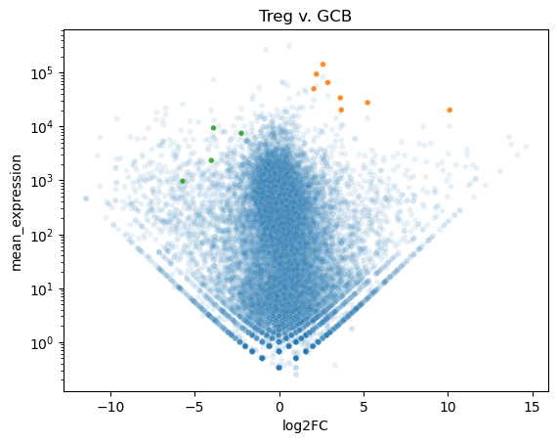
Comparing Expression profile of Tregs and GCB
Of Previously identified 50 highest expressing genes
Seven genes were higher in Tregs
B2M
JUNB
HLA-E
HLA-A
TRBC1
TRBC2
MALAT1
TRAC
Three genes were higher in GCB
CD74
EZR
HLA-DRB1
HLA-DRA

Slide 8
Potential Genes of Interest
B2M - Beta 2 Microglobulin MHCI related
JUNB – Transcription factor jun-B – regulatory Gene
HLA-E –MHC I related
HLA-A – MHC I related
TRBC1 – T cell receptor Beta constant 1
TRBC2 – T cell receptor Beta constant 2
TRAC – T cell receptor Alpha constant
CD74 – HLA class II
HLA-DRB1 – HLA Class II
HLA-DRA – HLA Class II

